Slide 1
TEAM - 05
DATA STRUCTURES MICRO PROJECT MAZE SOLVER
AKILESH G A - 23ISR002 BHARATH P - 23ISR008
SREE SETHU MADHAVAN D S - 23ISR054

Slide 2
CONTENTS
Introduction
Problem Statement
Methodology
Algorithm
Maze-Solver Puzzle
Output

Slide 3

INTRODUCTION TO MAZE SOLVER
A maze game is a game where a player navigates a complex network of paths to reach a goal or escape.
A maze is a path or collection of paths, typically from an entrance to a goal. The word is used to refer both to branching through puzzles.
Which the solver must find a route with minimum edges to reach goal.
PAC-MAN
Super Maze War CD-MAN

Slide 4
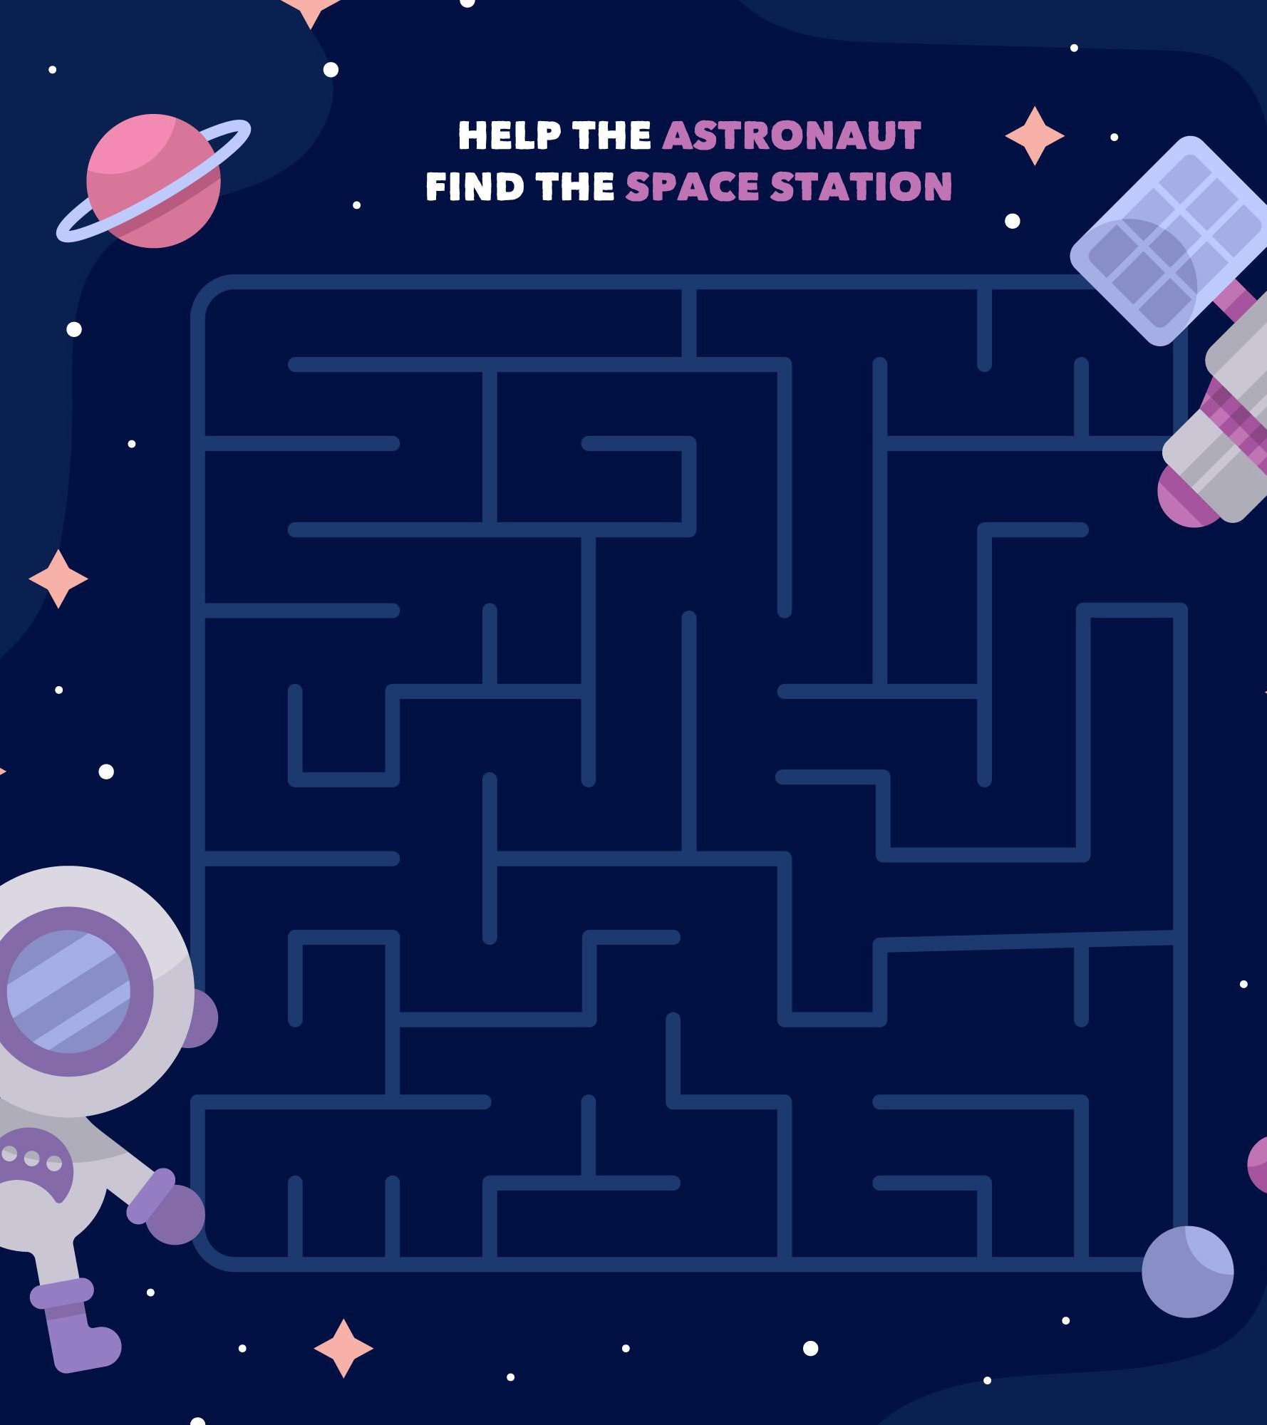
PROBLEM STATEMENT
A Maze solver game using a graph data structure involves representing the maze as a graph.
Where there are two points source and sink.
The goal is to achive the sink with shortest path in graph. By crossing Minimum Paths.

Slide 5
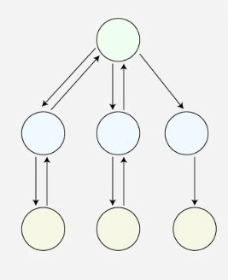
METHODOLOGY
Backtracking is the methodology used in the approach to find the solution.
Backtracking is a form of recursion. But it involves choosing only option out of any possibilities.
Backtracking is used to solve the puzzles by exploring the possible paths in the graph.

Slide 6
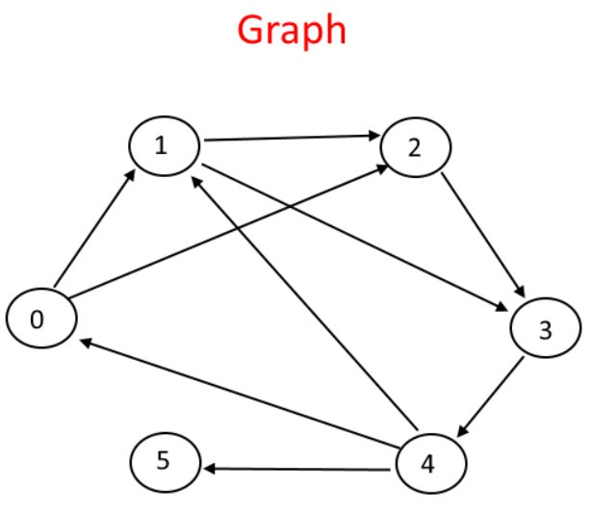
ALGORITHM
Breadth First Search (BFS) is a fundamental graph traversal algorithm.
It implemented with use of Graph Data structure.
It begins with a node, then first traverses all its adjacent. Once all adjacent are visited, then their adjacent are traversed.

Slide 7
MAZE SOLVER PUZZLE
import turtle
from random import randint myPen = turtle.Turtle() screen = turtle.Screen() screen.tracer(0) myPen.speed(0) myPen.hideturtle()
def text(message, x, y, size): FONT = ('Arial', size, 'normal') myPen.penup() myPen.goto(x, y)
myPen.write(message, align="left", font=FONT)
def box(intDim): myPen.begin_fill() for _ in range(4):
myPen.forward(intDim) myPen.left(90)
myPen.end_fill() myPen.setheading(0)
palette = ["#FFFFFF", "#000000", "#00ff00", "#0000ff", "#AAAAAA"]
maze = [
[1, 0, 1, 1, 1, 1, 1, 1, 1, 1, 1, 1, 1, 1, 1, 1],
[1, 0, 1, 1, 0, 0, 0, 0, 0, 1, 0, 0, 0, 1, 0, 1],
[1, 0, 0, 1, 0, 1, 1, 1, 0, 0, 0, 1, 0, 1, 0, 1],
[1, 1, 0, 1, 0, 0, 0, 1, 1, 0, 1, 0, 0, 1, 0, 1],
[1, 0, 0, 0, 0, 1, 0, 1, 0, 0, 1, 0, 1, 0, 0, 1],
[1, 0, 1, 0, 1, 0, 0, 1, 1, 1, 1, 1, 0, 1, 0, 1],
[1, 0, 1, 1, 1, 0, 1, 1, 0, 0, 0, 0, 0, 0, 0, 1],
[1, 0, 0, 0, 1, 1, 1, 0, 0, 1, 0, 1, 0, 1, 1, 1],
[1, 0, 1, 0, 1, 0, 0, 0, 1, 1, 0, 1, 0, 1, 0, 1],
[1, 0, 1, 0, 1, 0, 1, 1, 0, 0, 1, 0, 0, 0, 0, 1],
[1, 0, 1, 0, 1, 0, 0, 0, 1, 0, 1, 1, 0, 1, 1, 1],
[1, 0, 1, 1, 1, 1, 1, 0, 0, 0, 1, 0, 0, 0, 0, 1],
[1, 0, 0, 0, 0, 0, 1, 1, 1, 0, 1, 0, 1, 1, 0, 1],
[1, 1, 1, 0, 1, 0, 1, 0, 1, 0, 1, 0, 1, 0, 0, 1],
[1, 0, 0, 0, 1, 0, 0, 0, 0, 0, 1, 0, 0, 1, 0, 2],
[1, 1, 1, 1, 1, 1, 1, 1, 1, 1, 1, 1, 1, 1, 1, 1]
]

Slide 8
def exploreMaze(maze, row, col): if maze[row][col] == 2:
return True
elif maze[row][col] == 0: maze[row][col] = 3 myPen.clear() drawMaze(maze) screen.update()
if row < len(maze) - 1:
if exploreMaze(maze, row + 1, col): return True
if row > 0:
if exploreMaze(maze, row - 1, col): return True
if col < len(maze[row]) - 1:
if exploreMaze(maze, row, col + 1): return True
if col > 0:
if exploreMaze(maze, row, col - 1): return True
def drawMaze(maze): boxSize = 15 myPen.penup() myPen.goto(-130, 130) myPen.setheading(0)
for i in range(len(maze)):
for j in range(len(maze[i])): myPen.color(palette[maze[i][j]]) box(boxSize)
myPen.penup() myPen.forward(boxSize) myPen.pendown()
myPen.setheading(270) myPen.penup() myPen.forward(boxSize) myPen.setheading(180) myPen.forward(boxSize * len(maze[i])) myPen.setheading(0) myPen.pendown()

Slide 9
maze[row][col] = 4 myPen.clear() drawMaze(maze) screen.update() print("Tracking")
drawMaze(maze) screen.update()
solved = exploreMaze(maze, 0, 1) if solved:
print("Maze Solved")
text("Maze Solved", -100, -150, 20) else:
print("Cannot Solve Maze") text("Cannot Solve Maze", -130, -150, 20)
screen.update()

Slide 10
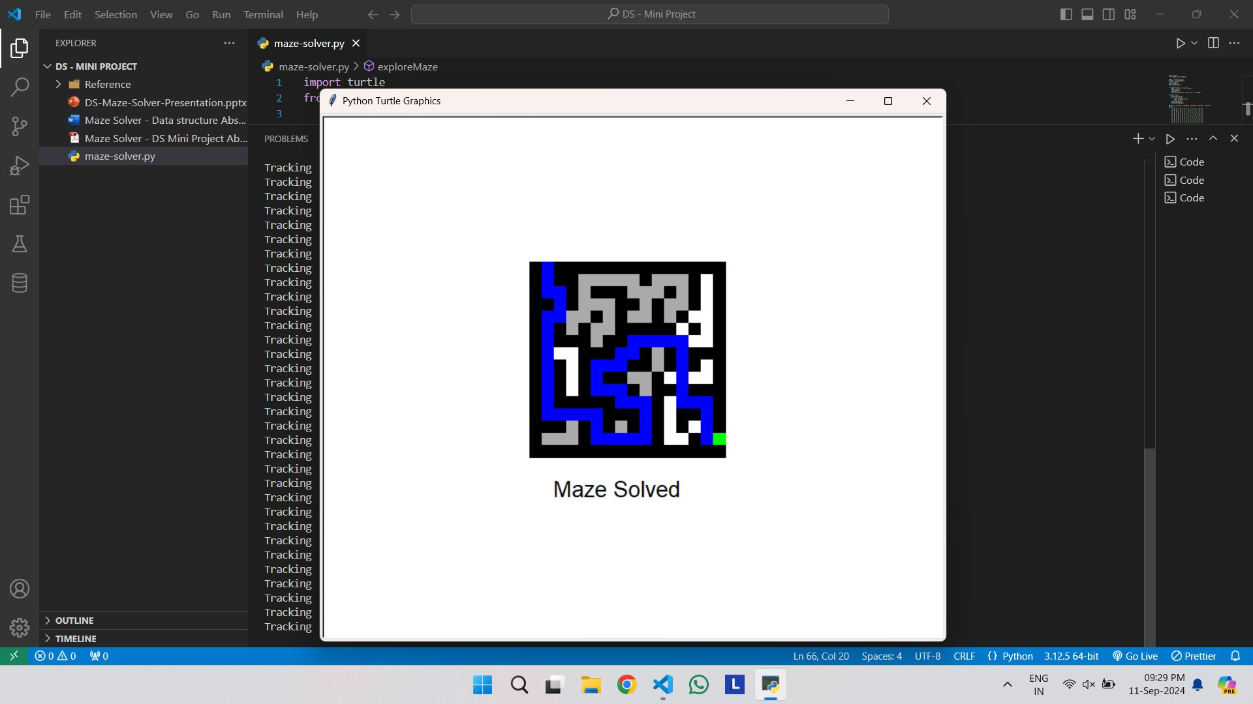
OUTPUT

Slide 11
GITHUB LINKS
https://akileshga.github.io/Maze_Solver/Maze-Solver-Web/home.html
https://github.com/Bharath05-P/Maze-Solver https://github.com/Sethu1912/Maze-Solver

Slide 12
THANK YOU

